Slide 1

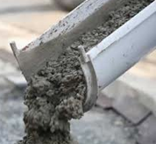
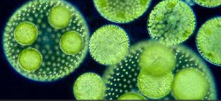
Navrattan
Crete
Creator of:
A Green“Geopolymeric ”Cement Binder

Slide 2
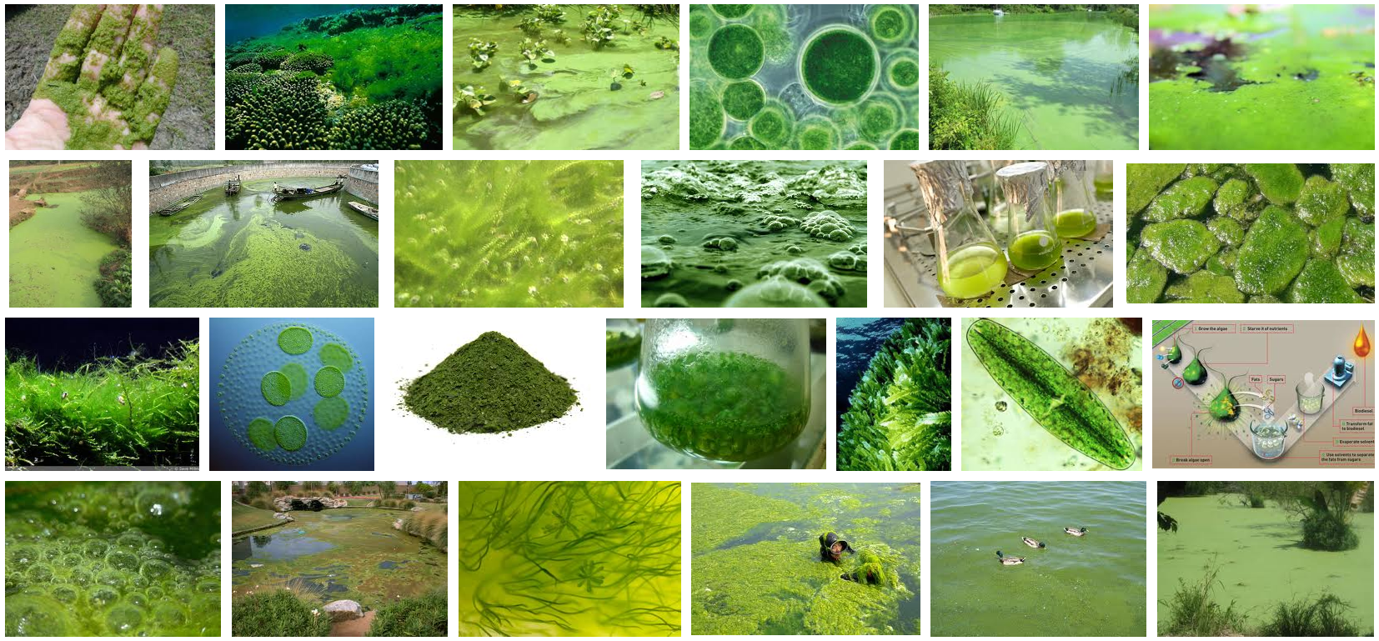
Algae have been estimated to include anything from 30,000 to more than 1 million species

Slide 3
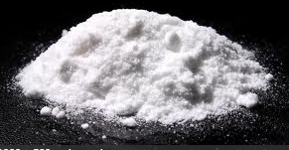
Our Technology uses a Proprietary Binder derived through a species of Algae, and a guarded extraction process, which ultimately transforms an Enzyme of the Algae into a highly concentratedElastic Polymeric Powder

Slide 4
The Magic of NC Cement Polymer is that it binds by Covalent Bonding which is a joining of two atoms when the two share a pair of electrons.
Shared Pair Electrons
8P
8N
8P
8N
Oxygen Molecule

Slide 5
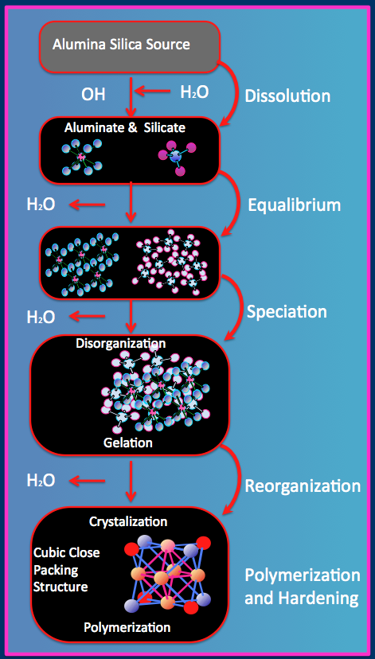
Individual polymer chains in the NC Proprietary binder are linked together by these Covalent Bonds to form one Single Molecule with all of the Aggregates.
In addition, a thin plastic film cross links and permeates the entire mixture adding flexibility.

Slide 6

Due to the Covalent Bonding nature of NC cement, it becomes Monolithic, and cures by an
Exothermic
Reaction, which intrinsically expels the water.
Exothermic Reaction
Water expels from the center out

Slide 7
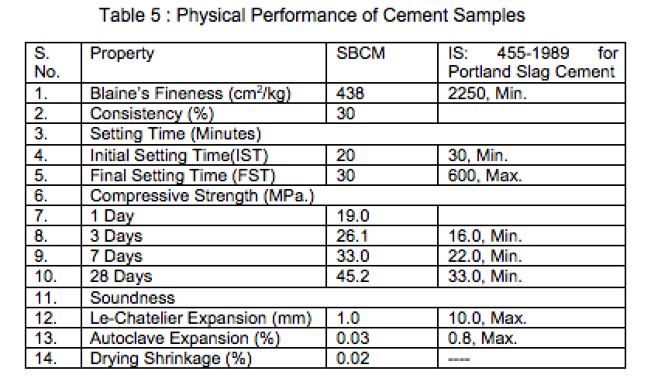
Structural Qualities
NC …..
Has Strengths that Can be Adjusted to Compression requirements
Has Higher Tensile Strength than Portland Cement due to its intrinsic covalent bonding nature.
Meets and Exceeds all the Same Testing Standards as ordinary Portland cement (OPC), and Excels in Every category.

Slide 8
Structural Qualities
NC…..
Has Low Coefficient of Expansion, and will work in freezing or tropical regions of the world.
Is Hydrophobic and therefore Highly-Resistant or impervious to water, acids, corrosion, sulfates and more..
Will NOT Corrode or Decompose Reinforcing, whether Steel, Fiberglass, Basalt, Hemp, or Bamboo.

Slide 9
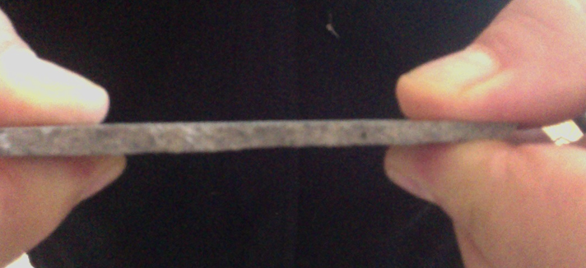
NC has High Tensile Strength
Tension applied on thin piece
NC Coating Material
ThisNCSample measures only 1/8” thick x 1” wide x 3” Long

Slide 10
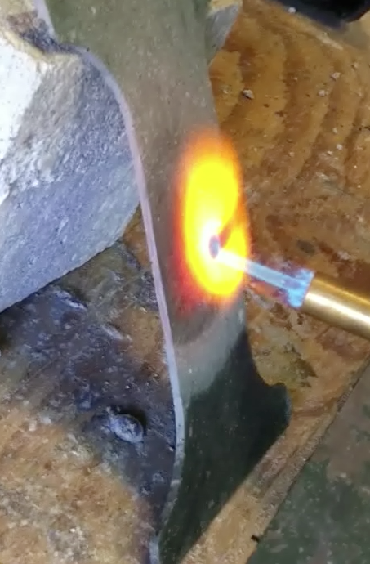
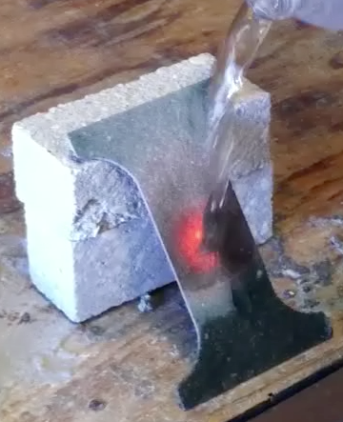
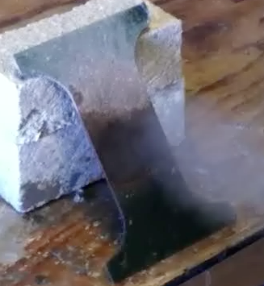
This is a WOW!!!
Does Not Explode
Thin saw cut NC Slice is Heated
Cold water Poured onto Hot NC Slice
This would be IMPOSSIBLE with Portland Cement

Slide 11
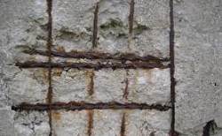
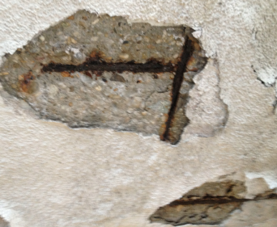
.
No More Rusty Re Bars
NC…….
NavrattanCrete absolutely Stops Oxidation ...your structures are forever.

Slide 12
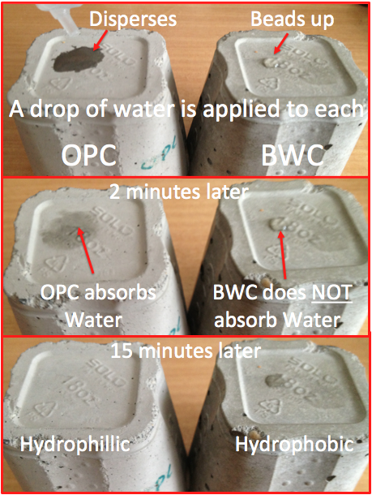
.
Permeablility.......Compare OPC withNC
NC
Is hydrophobic, which means liquids will not penetrate like they do with OPC.
Great for:
• Waterproof basements
• Pipe Coatings
• Countertops
• Wastewater tanks
• Fish Farms
• Boats, Docks
NC
NC

Slide 13
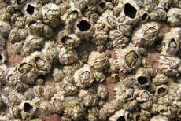
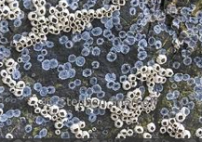
.
No Bacteria or Barnacles Can Live on NC
NC Surfaces are Ideal for Fish Farms, Boat Hulls, Docks
No Barnacles
No Bacteria

Slide 14
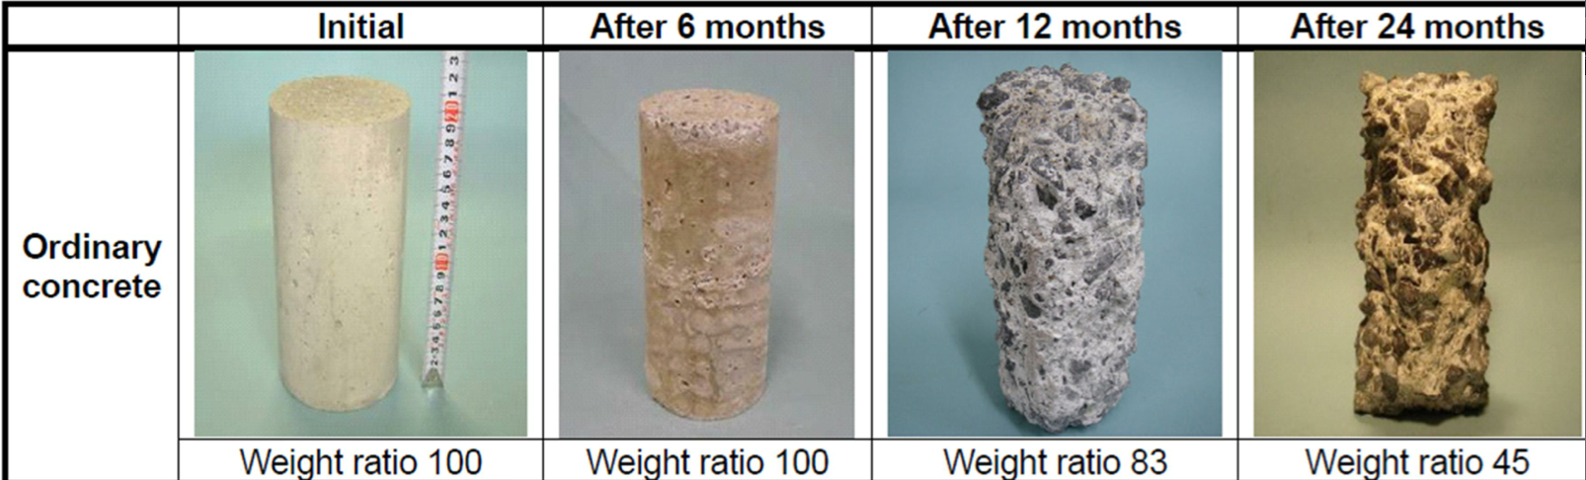
Acid will not Destroy NC
Portland Cement Deteriorating from exposure to Raw Sewage with 200 ppm Hydrogen Sulfide
A Portland Cement Block will dissolve in a Sulfuric acid solution in a few hours

Slide 15

.
NC will bond and Not Delaminate from Old Portland Cement
NC Bonds Without Chemical Additives

Slide 16

An Elastomer is a polymer with Viscoelasticity.
NC is Semi-Elastic Polymeric Cement that has Flexibility and Memory

Slide 17
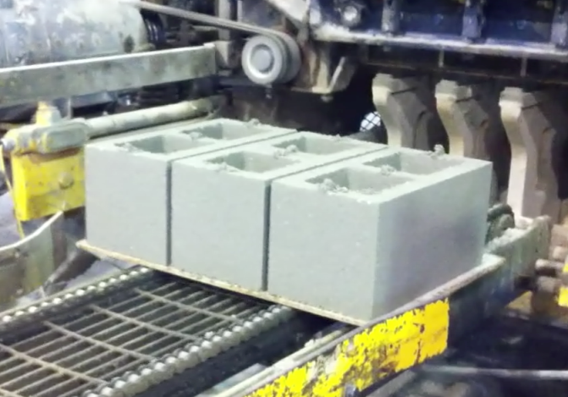
Set time
NC…….
Can be Adjusted for Quick Setting Applications as in in Pre-casting, Slip-forming, Extruding or Pultruding - and can at least double production using the same forms
Can be formulated to have an Adjustable Set Time from minutes to several hours.
NC Cement blocks every 8 Seconds

Slide 18
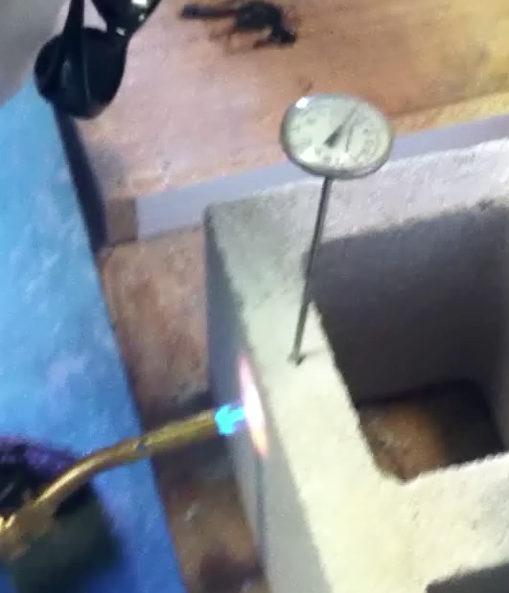
Super- Insulator – almost no heat transfer
NC binder gives the cement super insulating abilities no matter what aggregate is used – including cellulose or rock.
Portland blocks would probably explode with that much heat

Slide 19
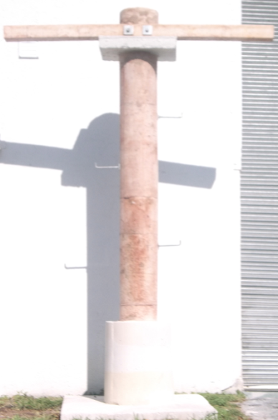
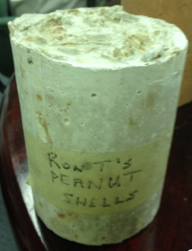
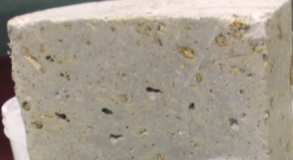
Wood Products
NC…….
Allows Wood Chips or Mulch to be used for aggregate, to create a wood-like material that won’t rot, burn, or be eaten by insects.
NC Wood Cutaway
NC Wood Pole

Slide 20

Cast Wood Pole
Is Nail-able, and Sounds like Wood when you hit it.
The many nails in the pole are from visitors

Slide 21

Personal Safety
NC…….
Will NOT Dry or Crack Skin, as lime based OPC does.

Slide 22
Application
NC…..
Can be Foamed, Painted, Rolled, or Sprayed.
Can be Delivered on the same trucks
as traditional Portland cement.

Slide 23
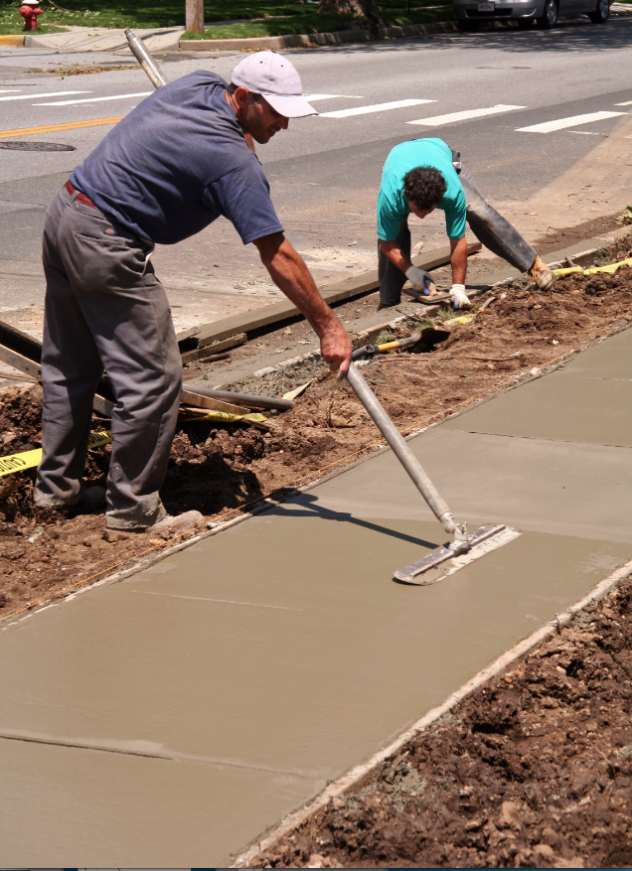
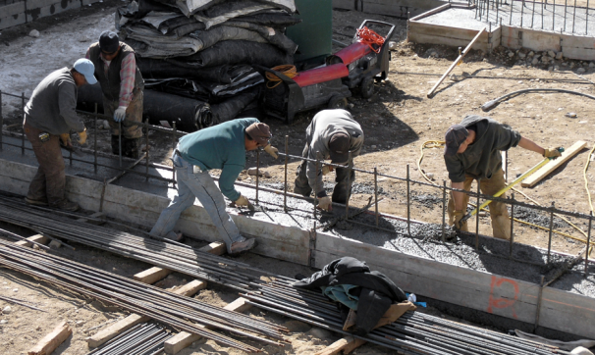
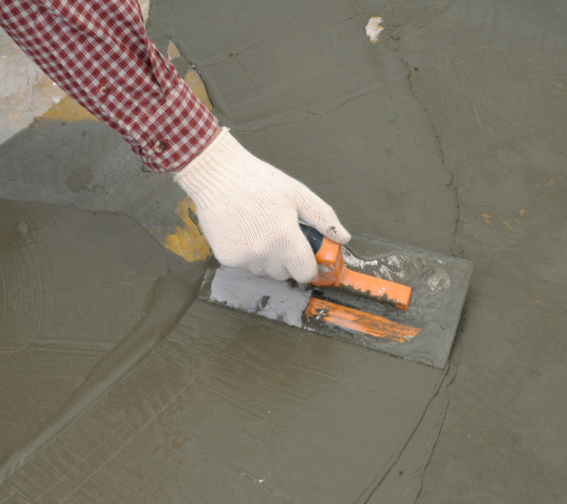
NC Finishes just like traditional Concrete
And uses same tools

Slide 24
Financial Advantage
NC …..
Can be Less Expensive to Produce than Portland Cement, and No Fossil Fuels or heating of materials are needed.
Can be Priced Competitively with traditional mixes of Portland cement due to its Low Production cost, or packaged and priced for high performance uses with a very High Profit Margin.
The actual cost will depend much on the availability of indigenous materials.

Slide 25
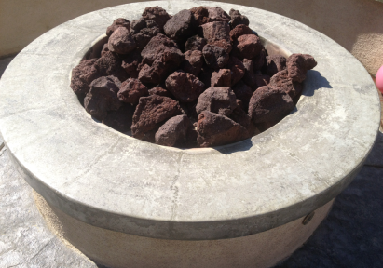
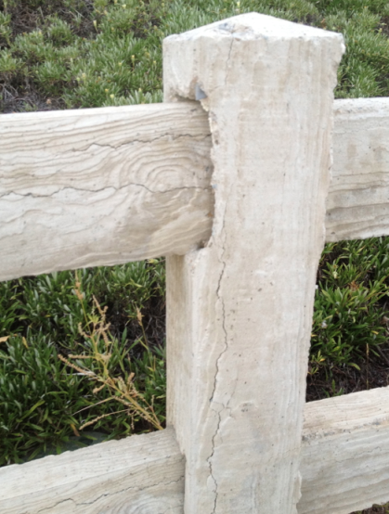

NC will Not Fall Apart and Crack like Portland
Ordinary Portland Cement (OPC) fire pit cracked. It is Less than 4 Years Old
Miles of Concrete Fencing in California Subdivision has Cracks in Every Post and Rail. It is only 5 years old.

Slide 26
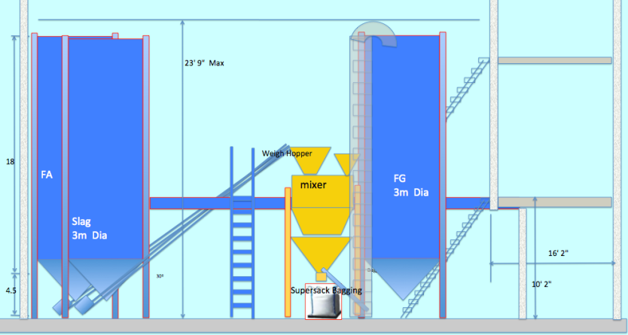
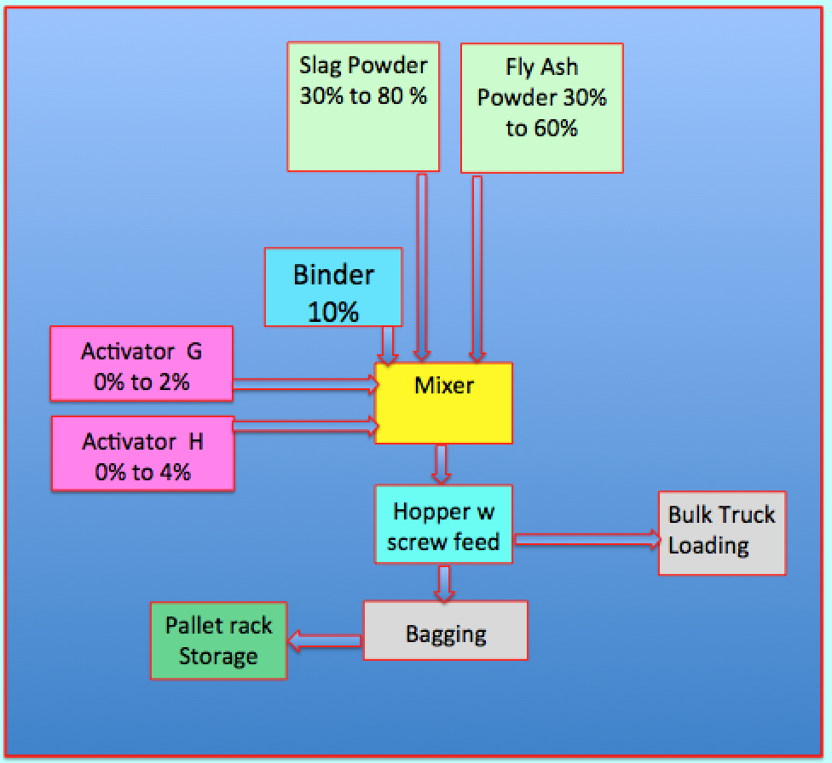
All you need is a Mixing Plant to Manufacture a Superior Green Cement
At a Fraction of the Cost.

