Slide 1


Slide 2


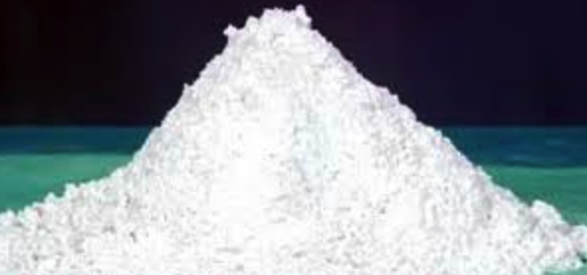
Navrattan White Cement
Navrattan White Cement is a specially manufactured cement that has revolutionized the development of architectural concrete. The use of Navrattan White Cement provides many building and construction applications with a wide range of aesthetic and decorative opportunities.
In addition to offering great design flexibility, Navrattan White is a quality product that implants proven high early strength and performance.

Slide 3
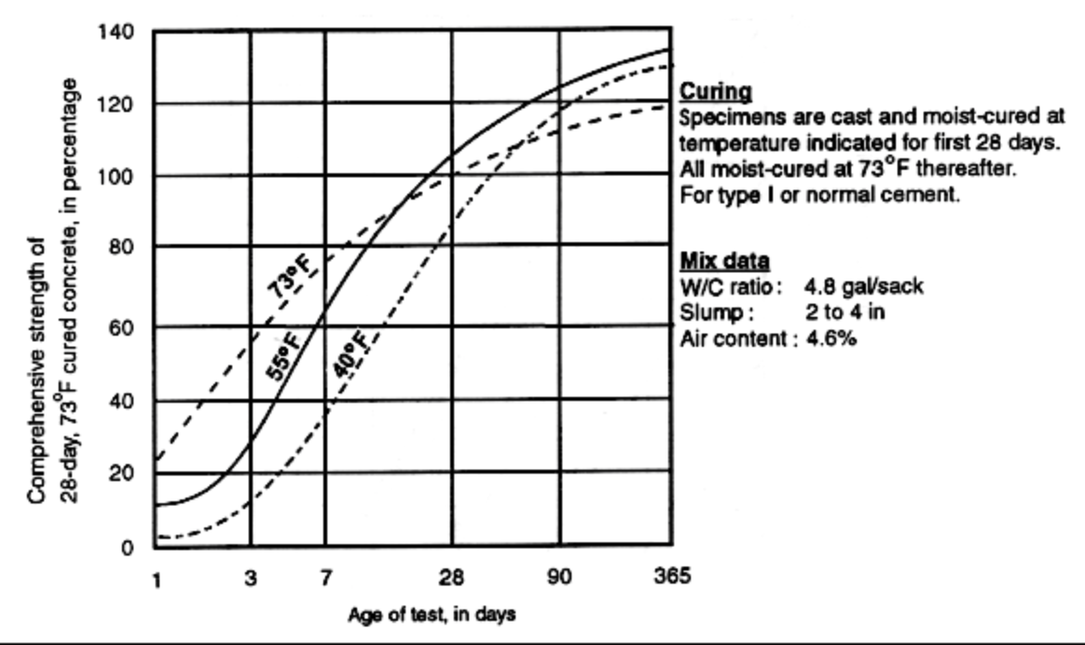
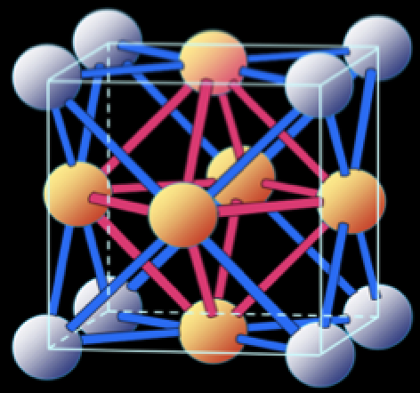
This Technology means even better performance
High Early strength development and shortercycle times in pre-cast manufacture.
Good mixing and blending capabilities means reliable strength combined with excellent bonding ability.

Slide 4
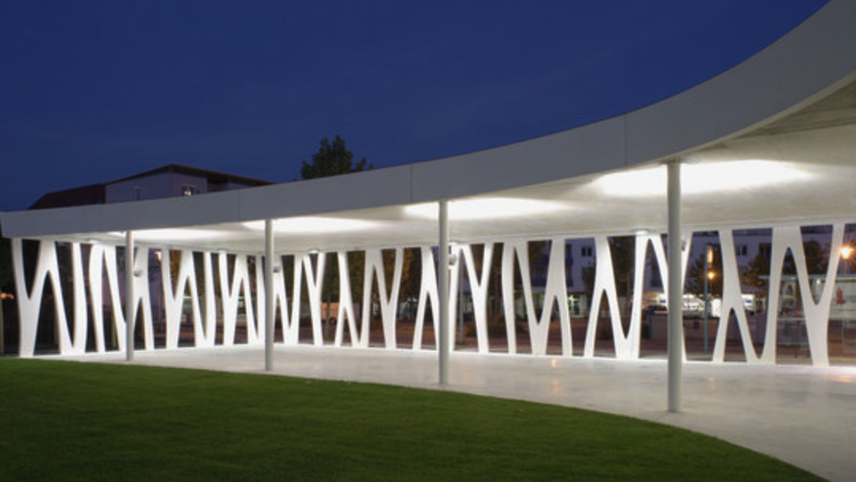
Suitable for a wide variety of aaplications
Navrattan White Cement uses its key features of whiteness and proven high early strength to deliver superior performance in the following uses:
Architectural Color finishes in buildings, bridges, retaining walls/barriers etc.
Pre-cast walls, columns, panels and floors

Slide 5
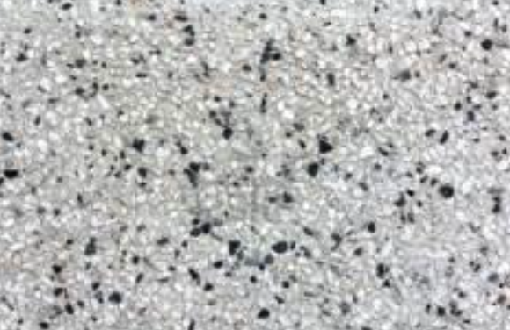
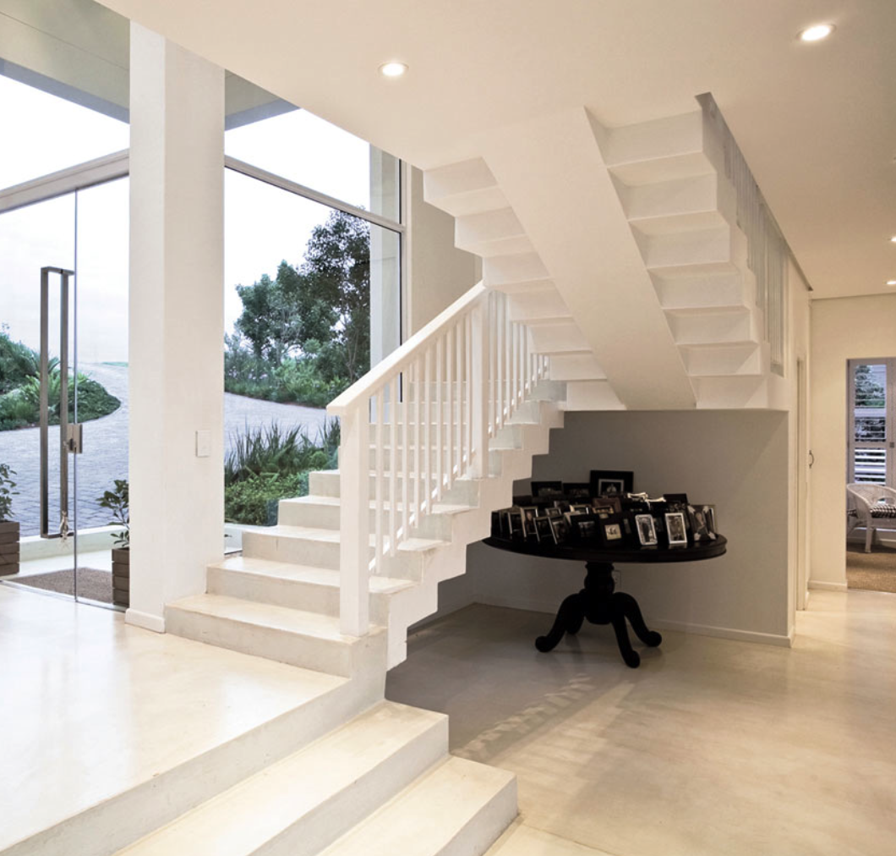
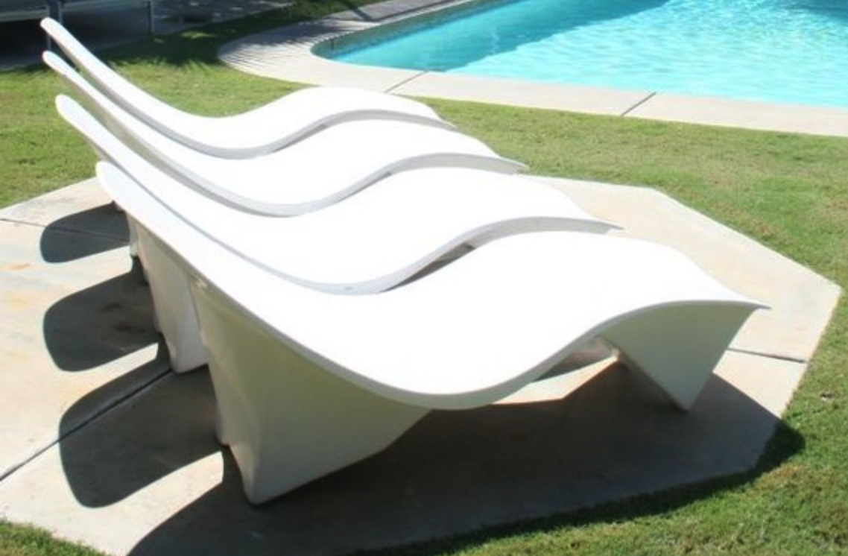
Suitable for a wide variety of applications
Pre-cast blocks and pavers
Colored mortars and render
Decorative pavements and terrazzo
Grout and tiling
Pool finishes and furniture
White Plastering

Slide 6
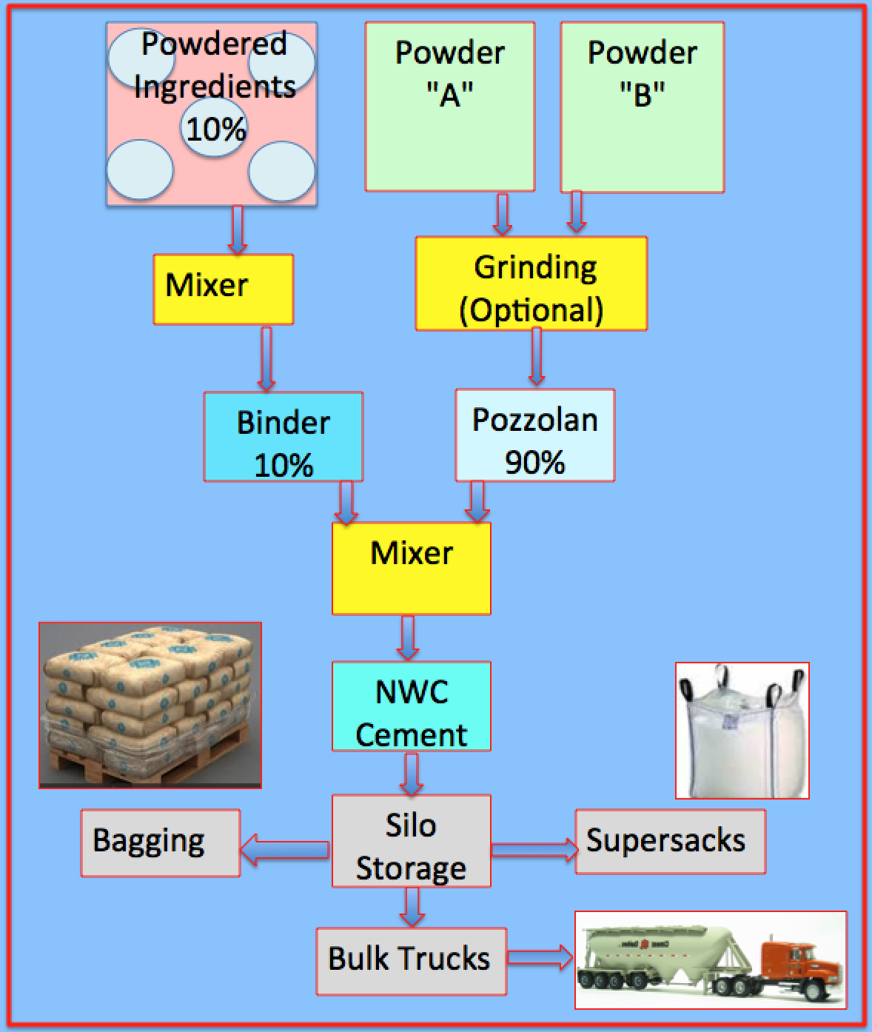
Minimum Cost for Plant Setup
There is a much lower capitalization cost for plant equipment than traditional White Portland Cement.
No Heating of Limestone is required.
Simple process

Slide 7
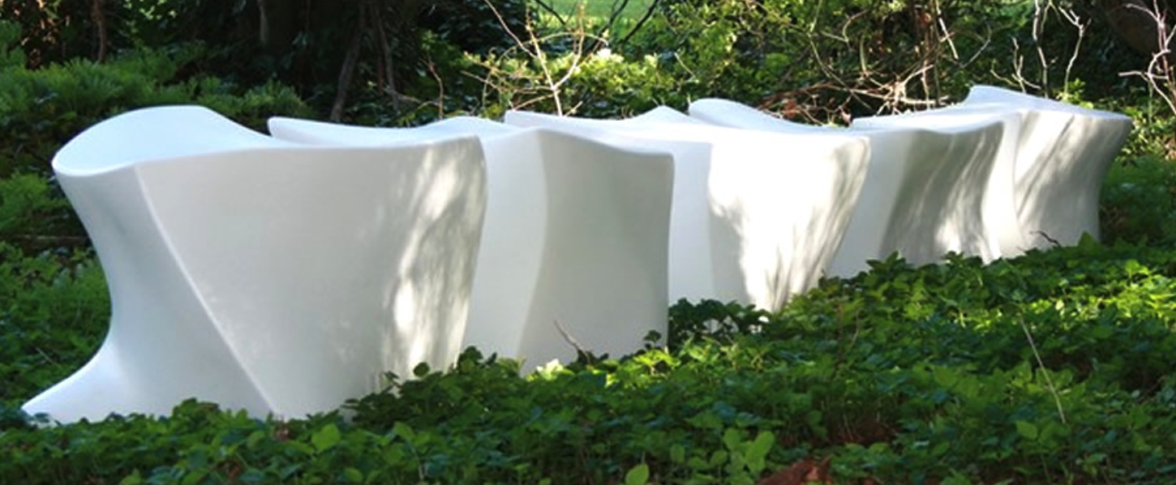
NO MAINTENANCE FOR LONG
Concrete and other products manufactured with Navrattan White Cement should require no additional maintenance if designed and constructed following proper and accepted procedures.

Slide 8
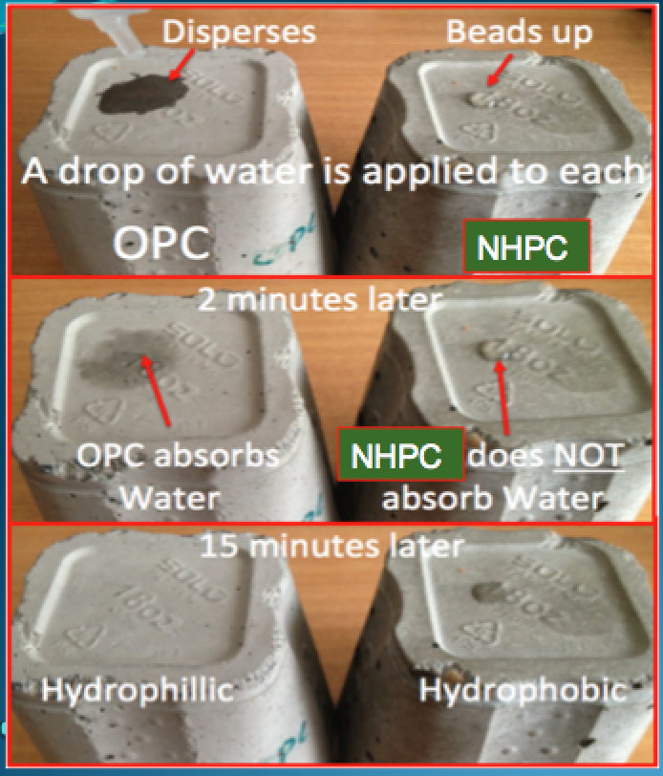
Original and Unique Formulation offers higher performance than Portland Products
Navrattan White Cement is hydrophobic, which means water is less likely to penetrate as it does with OPC.
Better bonding – we use a proprietary polymer binder in all of our High Performance blends
Excellent Workability
Variable set times available

Slide 9


NWC will bond and Not Delaminate from Old Portland Cement
Better bonding than 100% Portland based white cements
NWC Bonds Without extra Chemical Additives

Slide 10
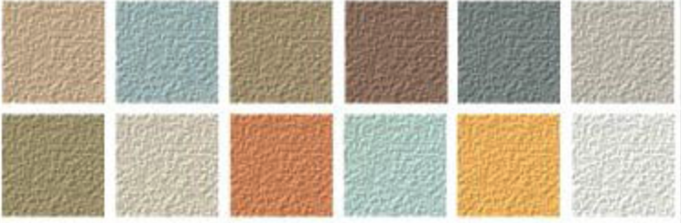
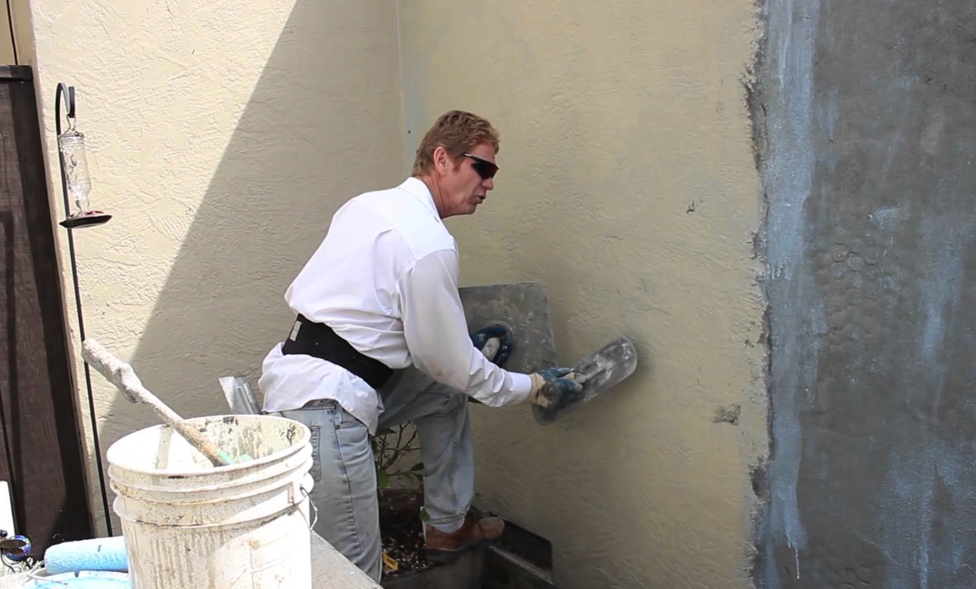
Decorative appeal for today's modern designs.
Easy to color using normal pigments can be added = a wide color spectrum.
Color consistency - Rich and True pastel colors

Slide 11


HUGE Profit Margins for NWC

Slide 12

Thank You for your undivided attention
NARATTAN WHITE CEMENT
For More Company Information
Click Below
http://www.navrattancement.com

